Slide 1
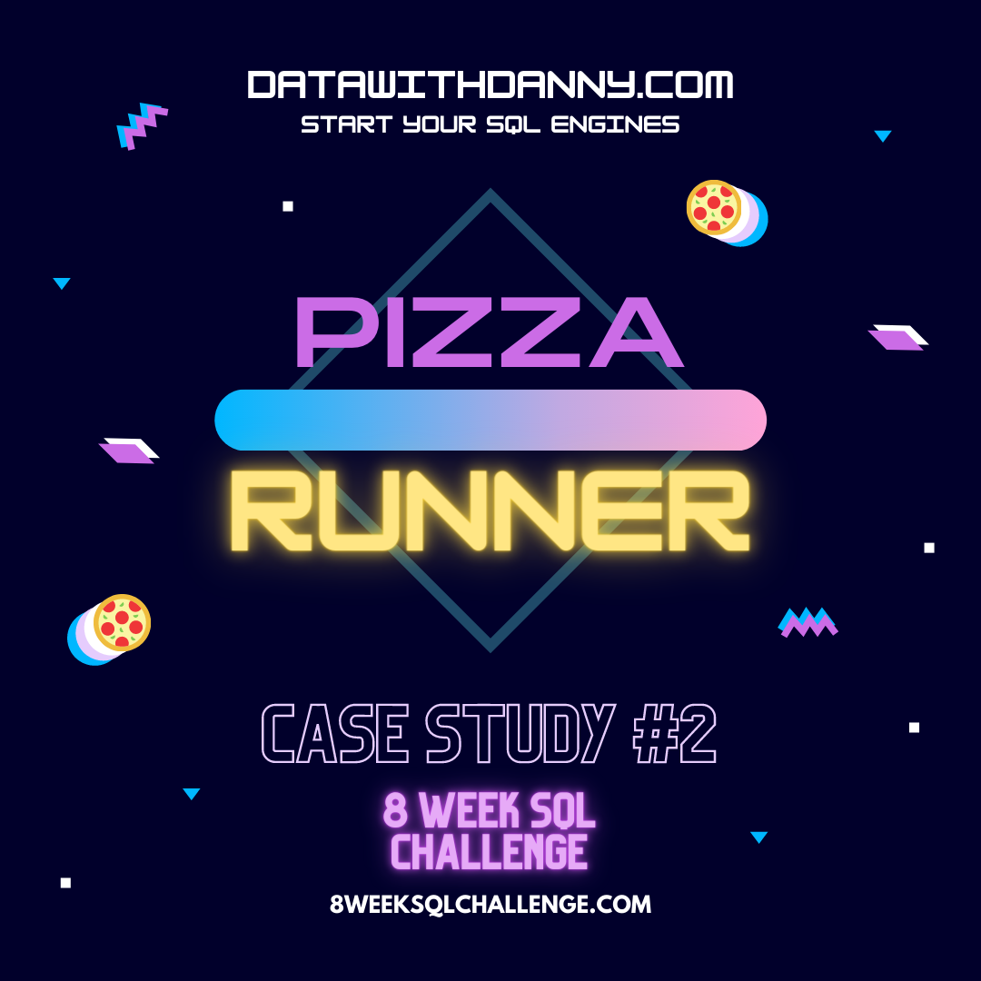
8 Week SQL Challenge Case Study #2 - Pizza Runner

Slide 2
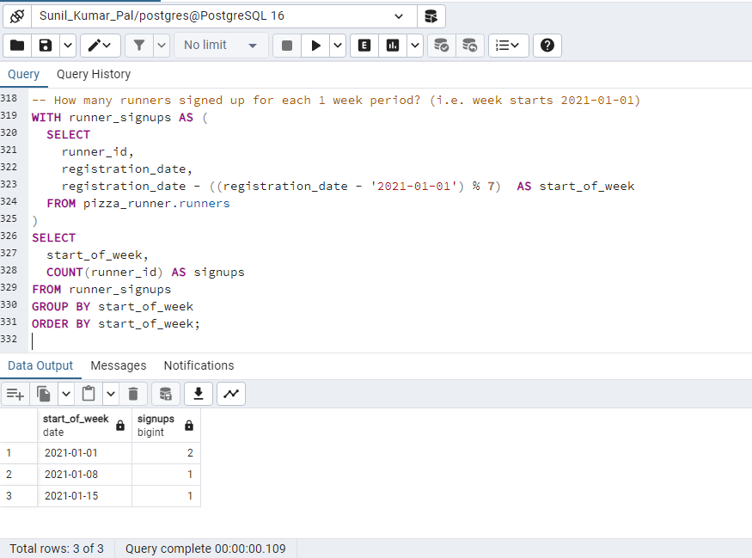
Part B. Runner and Customer Experience
How many runners signed up for each 1 week period? (i.e. week starts 2021-01-01)

Slide 3
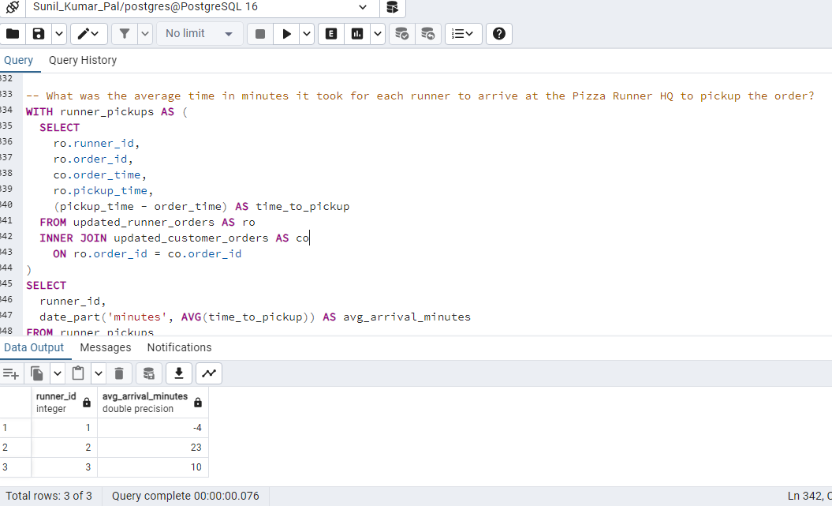
2. What was the average time in minutes it took for each runner to arrive at the Pizza Runner HQ to pickup the order?

Slide 4
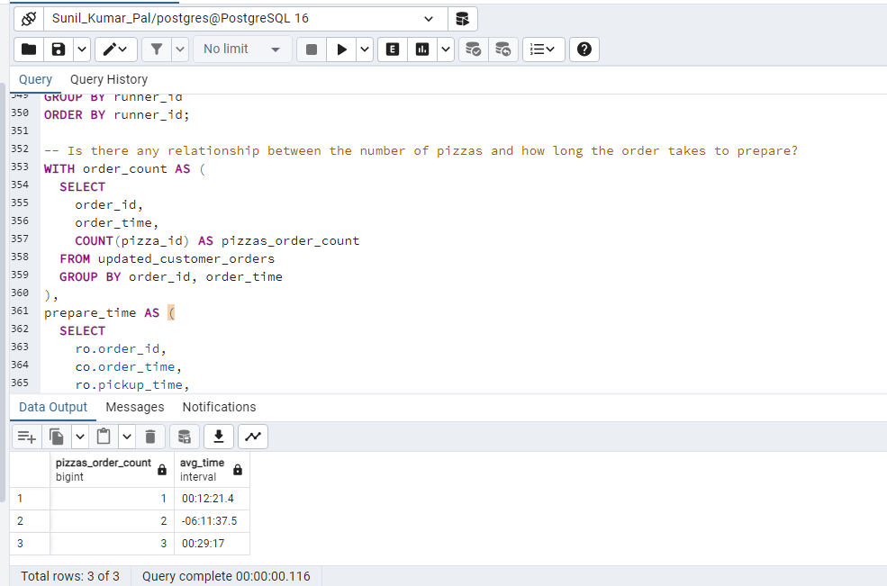
3.Is there any relationship between the number of pizzas and how long the order takes to prepare?

Slide 5
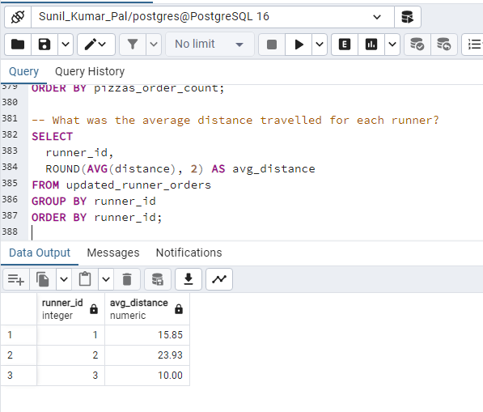
4. What was the average distance travelled for each customer?

Slide 6
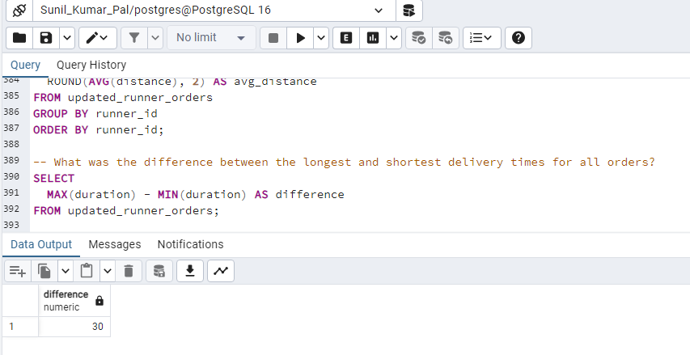
5. What was the difference between the longest and shortest delivery times for all orders?

Slide 7
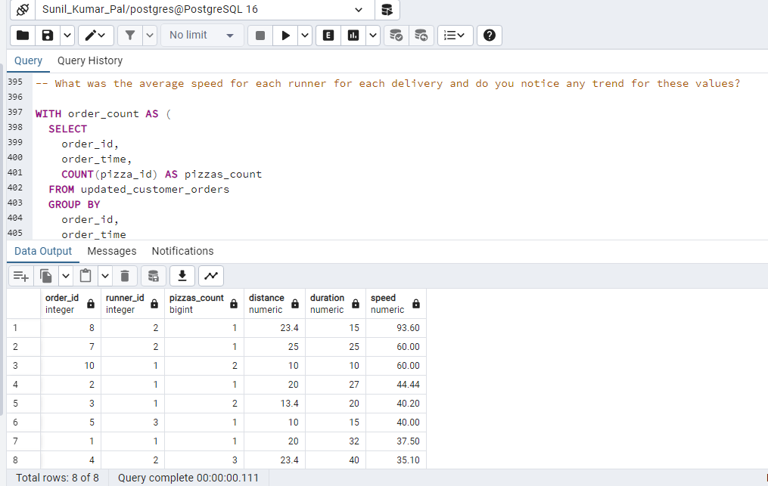
6. What was the average speed for each runner for each delivery and do you notice any trend for these values?

Slide 8
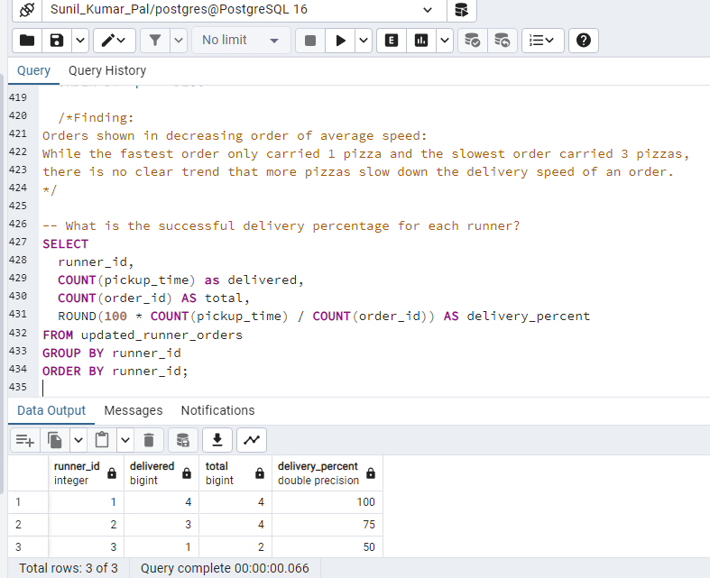
7. What is the successful delivery percentage for each runner?

